Slide 1
TREE MODELS
BUSINESS PROBLEM
DEMOGRAPHIC BASED MODEL: CHAID AND CRT
DEMOGRAPHIC & BEHAVIOURAL BASED MODEL: CHAID AND CRT
LOGISTIC REGRESSION
KEY FINDINGS
Yuanyuan Tong, Saral Joshi
Assignment 5

Slide 2
1
Business Problem
Using historical demographic and/or behavioural data of customers, high loyalty customers need to be identified and targeted. Validity of using demographic and behavioural variables for prediction of loyalty is to be justified over using only demographic variables. Also, risk of misclassification for high loyalty is to be minimized, since the company cannot afford to lose a prospective high loyalty customer due to error.
Implications:
Using Demographic data vs demographic + behavioural data
Danger of misclassifying a low loyalty customer as high loyalty customer vs Danger of misclassifying high loyalty customer as a low loyalty customer
Since target is high accuracy, high accuracy is needed in its prediction, hence more weightage should be given to cost of high loyalty misclassified as low loyalty, this will be tested.

Slide 3
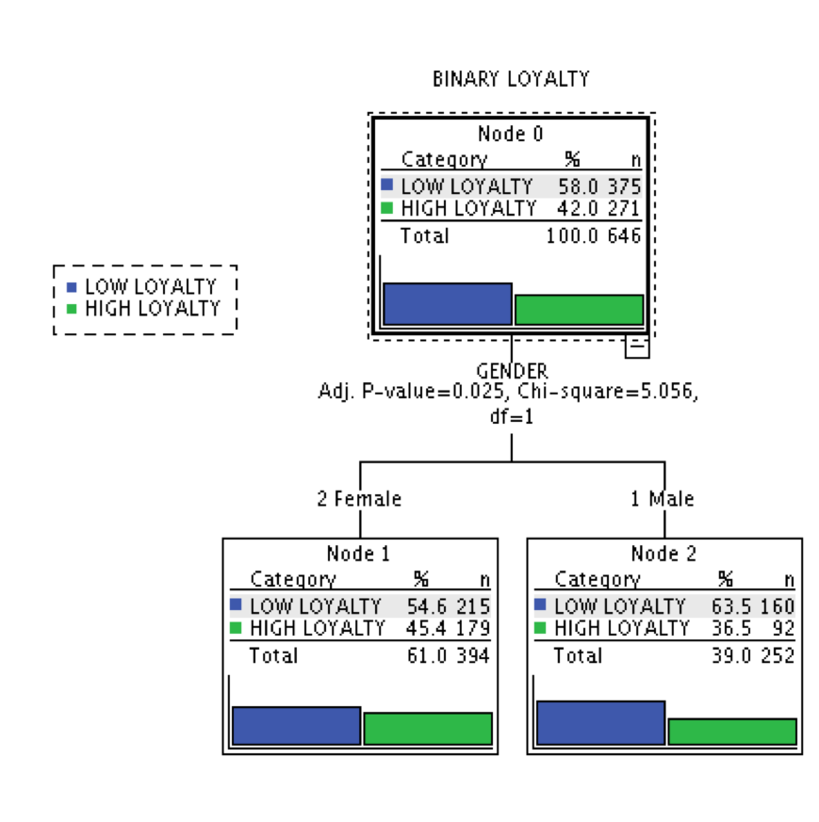
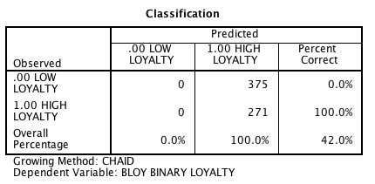
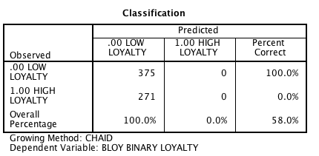
2
Model With demographic Variables Only - CHAID
Minimum Cases: Parent Node = 40 (6.7% of dataset) Child Node = 20 The model using only Demographics does not give good results. The algorithm in CHAID is unable to:
identify any statistically independent classifiers apart from gender and gives only one level, with a poor classification matrix.
It is also unable to improve accuracy when weightage is changed
The risk is also very high @ 50-60%, which means we will wring in classifying half the time
Cannot use this model since high loyalty customers will be missed and low loyalty customers will be targeted, which is a waste of resources.
1 level tree, with 50-60% misclassification
weightage=2 for High loyalty
Classification with equal weightage

Slide 4
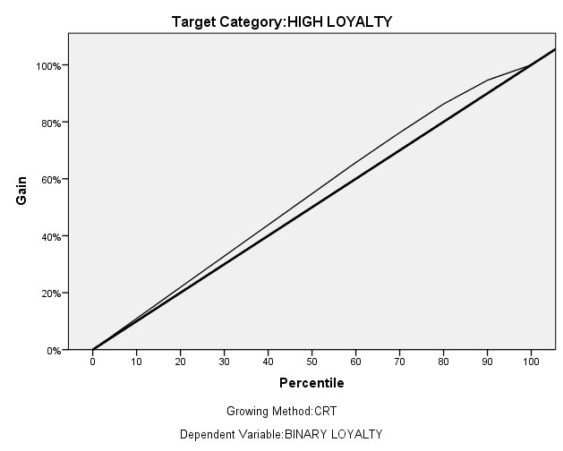
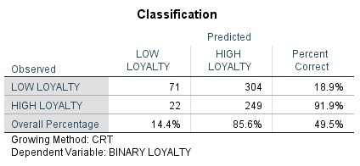
3
Model With demographic Variables Only - CRT
Minimum Cases (different sizes): Parent Node = 60 Child Node = 30 The model gives deceivingly good results, the
3 level tree with Education, marital status and income as classifiers.
High misclassification accuracy for high loyalty @ 91.9%, sounds perfect but,
Risk is high @ 54%
On increasing or decreasing the Parent node & Child node criteria results will change, this shows the model is unstable and CRT is giving us an over fitted model, which has 100% accuracy at Parent node= 100, child node = 50
Cannot use this model since low loyalty customers will be easily classified as high loyalty.
Poor Gain chart results, model nearly flat
weightage=2 for High loyalty. Large value for high loyalty because of over fitting.

Slide 5
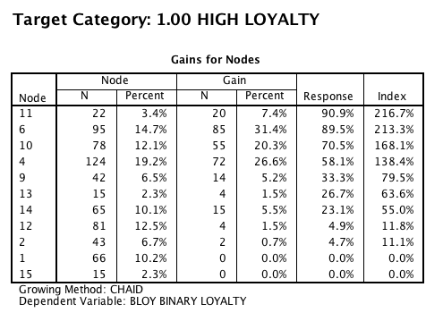
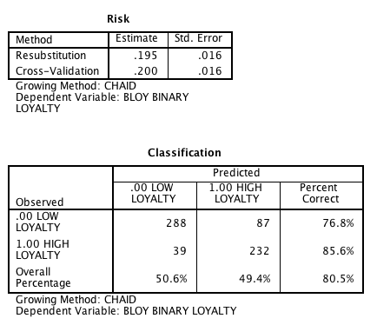
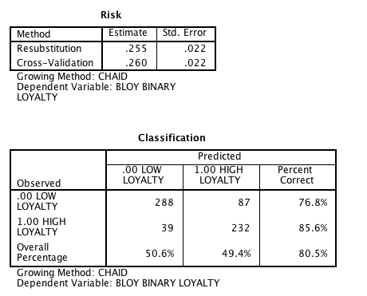
4
Model With Demographic and Behaviour Variables - CHAID
Minimum Cases: Parent Node = 40 (6.7% of dataset) Child Node = 20
3 multi split levels, value as primary splitter, based on optimum values computed by CHAID
Good gain table, which shows the model is a good improvement over a random set
On increasing or decreasing the Parent node & Child node criteria results are constant. This indicates no overfitting.
On changing weightage to 1-4 (High loyalty) or 0.4 to 0.8 (low loyalty), classification accuracy does not change, though risk statistic keeps fluctuating.
Only drawback of this model is that the tree model has 6 splits based on value, which are of little business significance. A manager could work 1-3 splits, but 6 is not useful.
Good Gain table results
Equal Weightage
High loyalty Weightage=2

Slide 6
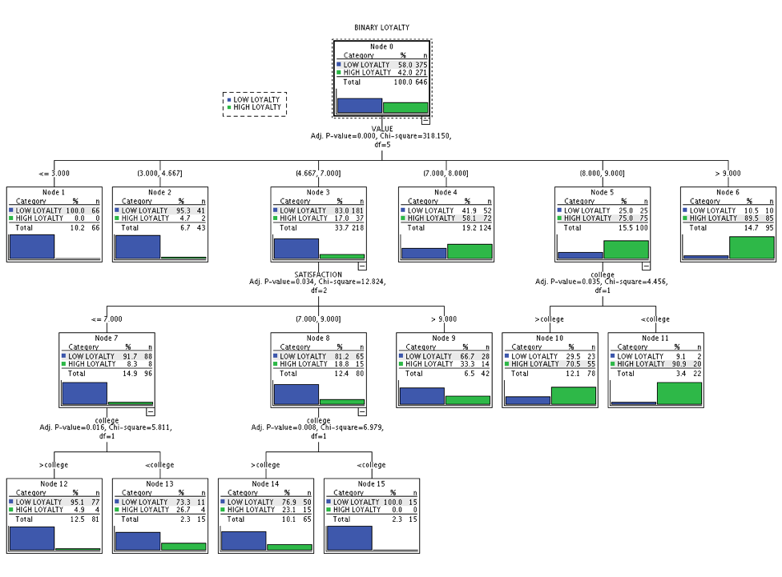
5
Model With Demographic and Behaviour Variables - CHAID
First level does not have any direct business significance, this is a problem with CHAID method, where continuous data is split into bins based on statistical significance of splitting tests, it doesn’t always coincide with business needs. In this case no clear segmentation has emerged, even though the model is statistically good.
CHAID based model with behavioural variables

Slide 7
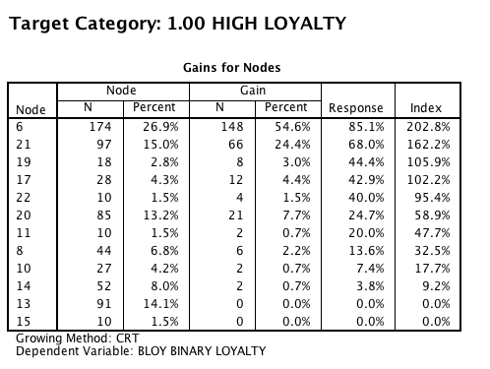
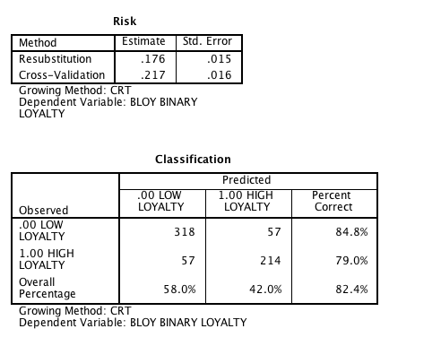
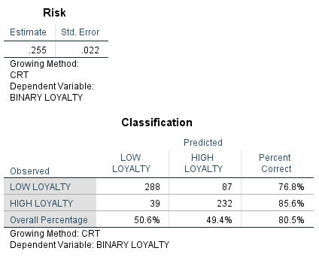
6
Model With Demographic and Behaviour Variables - CRT
Minimum Cases: Parent Node = 40 (6.7% of dataset) Child Node = 20
5 binary split levels, value as primary splitter, based on homogeneity estimates computed by CRT.
Percent misclassification same as CHAID, Gain table risk estimate comparable to CHAID (risk slightly higher)
Both models give similar results but CRT method gives us a better path to segmentation, since the splits are all binary for satisfaction and value. And the split is based on homogeneity.
Assigning weight of two to high loyalty gives a better misclassification estimate, between 2-3 risk estimates change, but beyond 3, the misclassification for low loyalty is too high
Simple crosstab analysis based on the tree model reveals that the most likely high loyalty customer is Female, 25-34, edu-level college, married with income between 35-70K
Good Gain table results
High loyalty Weightage=2
Equal Weightage

Slide 8
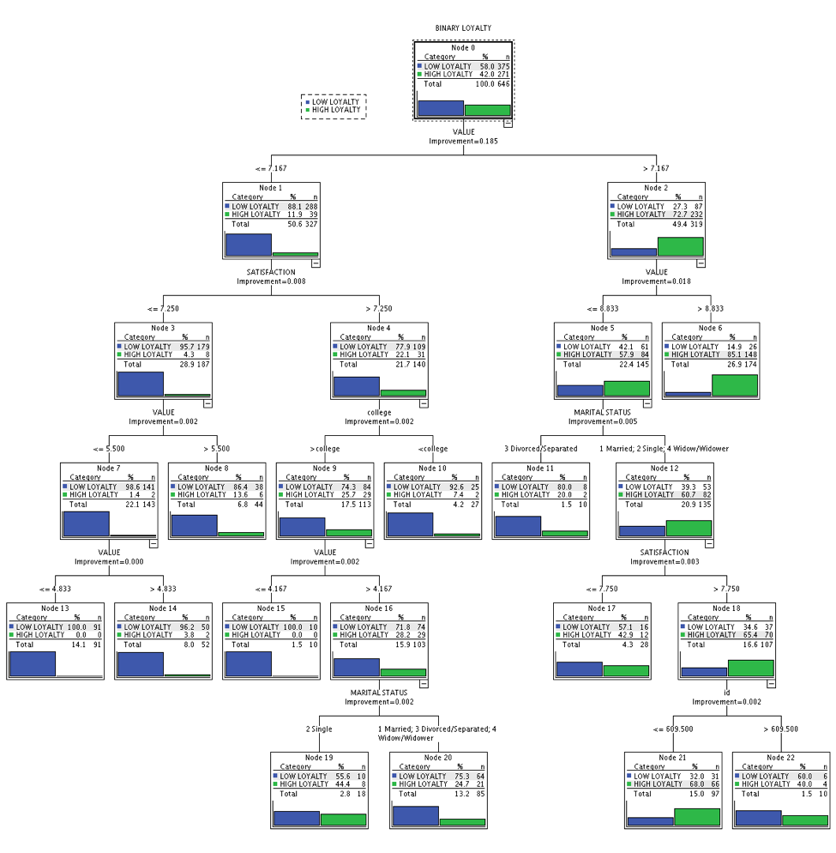
7
Model With Demographic and Behaviour Variables - CRT
The CRT model is able to give us some sense of direction and insights as to where to look at. It’s showing us that married people, even though have lower value perception of the company’s product, are still more likely to be a loyal customer set. If we go further deep in this set, higher satisfaction levels coincide with high loyalty. Though CHAID can also do this, CRT is better in this case because it splits the continuous variable in, a business sense, to binary in the model.
Recommended CRT based model with behavioural variables

Slide 9
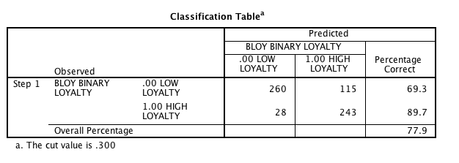
8
Using Logistic regression
A logistic regression model with 0.3 cut-off gives us a better classification table as seen in table to the right. The logistic method gives us a high percent correct for both high loyalty and low loyalty, while avoiding over fitting. Important variables that emerged from regressions are : Value Age (4) : i.e. 45 to 54 year old (though significance is not statistically relevant, reducing the number of variables may eventually lead to more variables being added.
Classification table - logistic
Variables in logistic model

Slide 10
9
Key Findings
High loyalty customers are most likely to be : Female, 25-34, education-level college, married with income between 35-70K.
We were able to build a model to predict high loyalty customers with 85.7% accuracy , based on CHAID and CRT both; and around 20% associated risk that the prediction is miss classified. Gain charts indicate that the models are statistically good.
CRT model is better from business point of view since it allows for better segmentation in this problem. It can be used more flexibly on new datasets since it allows pruning.
There is a trade-off between having higher than 85.7% prediction correctness in high loyalty, while losing prediction accuracy in low loyalty. If the long term benefits of adding a few extra high loyalty customers under this program, outweigh the losses incurred due to reaching out to the misclassified low loyalty customers; then the model can be shifted to a higher accuracy. Although 86% accuracy is pretty high.
It is clear that behavioural variables are critical to the model, using value and satisfaction has brought down the risk estimate down to half.
Logistic regression gives us a better model, along the same lines as decision tree, i.e. value remains the most important distinction.

